Slide 1
Manufacturing Technology 03/02/2018 (Friday Schedule) (ME461)
Instructor: Shantanu Bhattacharya

Slide 2
Basic steps in developing a process plan
Analysis of part requirements.
Selection of raw work piece.
Determining manufacturing operations and their sequences.
Selection of machine tools.
Selection of tools, work holding devices, and inspection equipments.
Determining machining conditions (cutting speed, feed and depth of cut) and manufacturing times (setup time, processing time, and lead time).

Slide 3
The principal process planning approaches
The principal approaches to process planning are the manual experience based method and the computer aided process planning method.
The manual experience-based planning method:
The manual experience based methods have the same steps for manually generating a process plan as described earlier. However, it is a time consuming and inconsistent approach.
The feasibility of process planning is dependent on many upstream factors such as design and the availability of machine tools.
Also, a process plan has a great influence on many downstream manufacturing activities such as scheduling and machine tool allocation.
Therefore, to develop a process plan, process planners must have sufficient knowledge and experience. It may take a relatively longer time and is usually expensive to develop the skill of planners.

Slide 4
Computer aided process planning
The primary purpose of a process planning activity is to translate a design of any product into manufacturing process details.
This prima facie suggests a feed forward system in which the design information is directly processed by a CAPP system to layout a manufacturing plan. However, this does not rhyme very well with the concurrent engineering philosophy where design is an integral part in all steps of a manufacturing unit.
So, somehow we have to integrate the CAPP system into the inter-organizational flow.
For example if we change the design we should be able to fall back on a CAPP system to generate cost estimates of these design changes.
Similarly, if there is a breakdown the CAPP should be able to suggest an alternative plan so that the most economical situation can be adopted.
The two major methods that are used in computer aided process planning: the variant CAPP and the generative CAPP method.

Slide 5
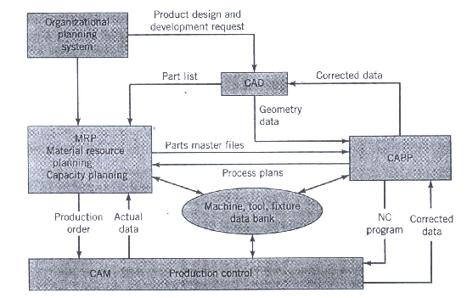
Framework for a CAPP system

Slide 6
The variant CAPP method
In the variant process planning approach, a process plan for a new part is created by recalling, identifying, and retrieving an existing plan for a similar part making necessary modifications for the new part.
Quite often, process plans are developed for parts representing a family of parts. Such parts are called master parts.
The similarities in design attributes and manufacturing methods are exploited for the purpose of formation of part families.
A number of methods have been developed for part family formation using coding and classification systems of group technology (GT), similarity coefficient based algorithms, and mathematical programming models.

Slide 7
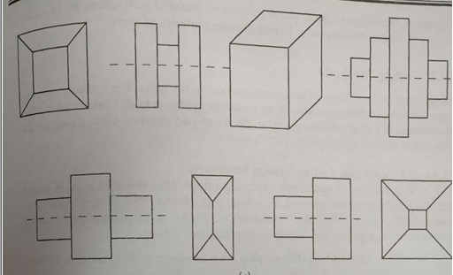
Part families
How can we classify?

Slide 8
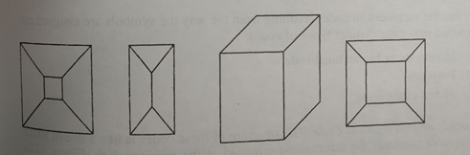
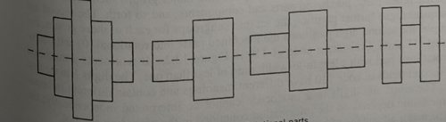
Two classifications
PRISMATIC PARTS
ROTATIONAL PARTS

Slide 9
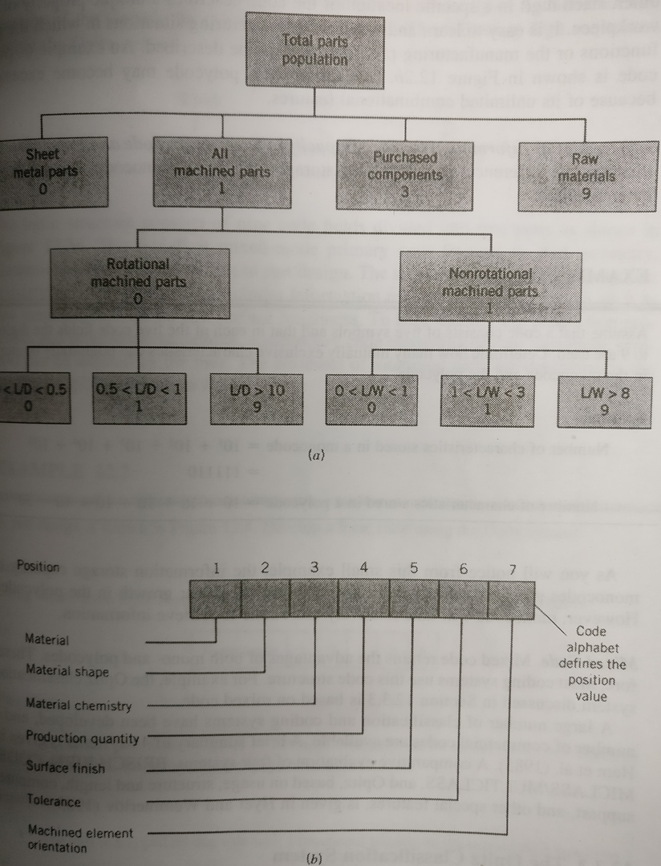
GT monocode/ polycode technique

Slide 10
4-steps to variant process planning
Define the coding scheme: Adopt existing coding or classification schemes to label parts for the purpose of classification.
Group the parts into part families: Group the parts into part families using the coding scheme selected earlier based on commonality of part features.
Develop a standard process plan: Develop a standard process plan for each part family based on the common features of the part types. This process plan can be used for every part type within the family with suitable modifications.
Retrieve and modify the standard plan: When a new part enters the system, it is assigned to a part family based on the coding and classification scheme. Then the corresponding standard process plan is retrieved and modified to accommodate the unique features of the new part.

Slide 11
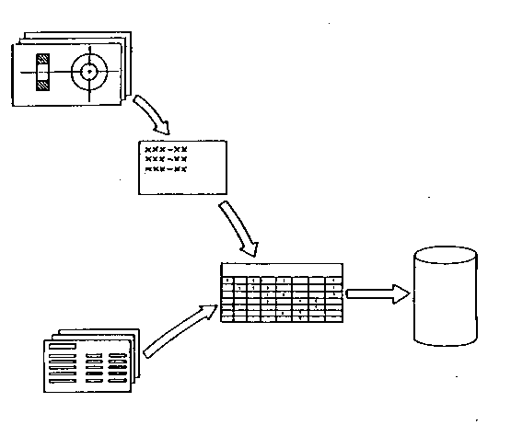
1. PREPARATORY STAGE OF
VARIANT
PROCESS PLANNING
Part Drawing
Coding
Family One
Standard
Plan
File
Family Formation
(Indexed
by Family
Matrix)
Process Plan

Slide 12
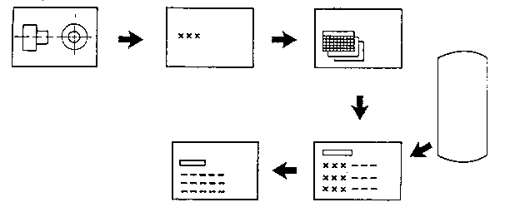
2. PRODUCTON STAGE OF VARIANT
PROCESS PLANNING
Coding
Family Search
Standard
Plan
File
Process Plan
Editing
Standard Plan
Retrieval

Slide 13
Some commonly used variant approaches
One of the most widely used systems is computer aided process planning, developed by Mcdonnell-Douglass Automation company under the direction of CAM-I (Computer Aided Manufacturing International).
The other popular variant is the MIPLAN, developed by OIR (Organization for industrial research) and General Electric Company (Hurzeel, 1976).

Slide 14
The generative CAPP method
In the generative approach, process plans are generated by means of decision logic, formulas, technology algorithms, and geometry based data to perform uniquely the many processing decisions for converting a part from raw material to a finished state.
There are two major components of a generative process planning system.
A geometry based coding scheme.
Process knowledge in the form of decision logic and data.

Slide 15
Geometry based coding scheme
The objective of a geometry based coding scheme is to define all geometric features for all process related surfaces together with feature dimensions, locations, tolerances and the surface finish desired on the features.
The level of detail is much greater in a generative system than a variant system.
For example, such details as rough and finished states of the parts and process capability of machine tools to transform these parts to the desired states are provided.

Slide 16
Process Knowledge in the form of decision logic and data
Basically, the matching of part geometry requirements with the manufacturing capabilities is accomplished in this phase using process knowledge in the form of a decision logic and data.
All steps related to process planning is automatically carried out.
Examples include process selection, machine tools, tools, jigs and fixture, materials, inspection equipments and sequencing of operations.
Setup and machining times are calculated.
Operation instruction sheets are generated to help the operators run the machines in the case of manual operations.
If the machines are numerically controlled, the NC codes are automatically generated.

Slide 17
Basis of Process Knowledge method
Manufacturing knowledge is the backbone of process planning is not a one time activity but a recurring dynamic phenomena.
Furthermore the sources of manufacturing knowledge are many and diverse, such as the experience of manufacturing personnel; handbooks; suppliers of major machine tools, tools, jigs or fixtures, materials and inspection equipments and customers.
To use this wide spectrum of knowledge ranging from qualitative and narrative to quanitative, it is necessary to develop a good knowledge structure to help provide a common denominator for understanding manufacturing information, ensuring its clarity and providing a framework for future modifications. Tools available for this purpose are flowcharts, decision trees, decision tables etc.

Slide 18
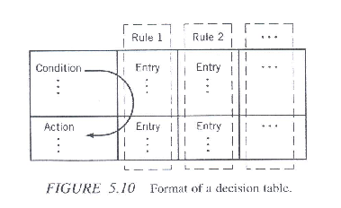
Decision Tables
Decision tables provide a convenient way to document manufacturing knowledge.
They are principle elements of all decision table-based process planning systems.
The elements of a decision table are conditions, actions, and rules.
They are organized in the form of an allocation matrix as shown in the table below where the conditions state the goal we want to achieve and the actions state the operations we have to perform.
The rules formed by entry values according to the experience of experts, establish the relation between conditions and actions.

Slide 19
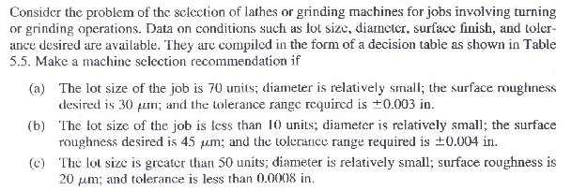
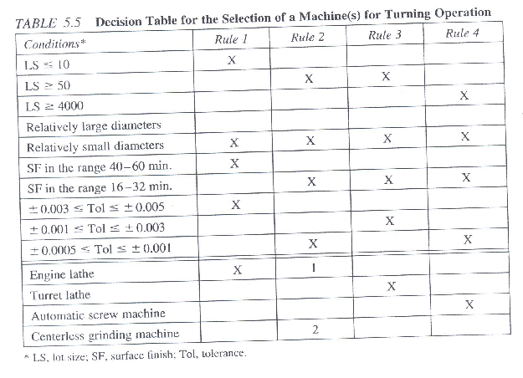
Problem statement to be solved with Decision Table

Slide 20
Solution
From the set of conditions given in the problem, it is easy to see from the table that the rule 3 is suitable for this situation. The action, therefore, is obviously turret lathe; that is, the operation is performed on a Turret Lathe.
Similarly, the solution is engine lathe.
From the conditions given in the problem, we find that rule 2 is most suitable. Therefore, the recommended actions are to finish parts on an engine lathe and subsequently on a center-less grinding machine to achieve the desired specifications.

Slide 21
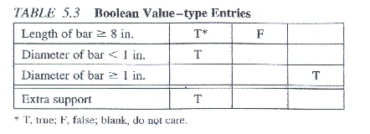
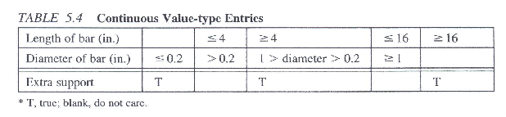
Decision Tables
Entries can be either Boolean-type values (true, false and do not care) or continuous values. Tables below show this.
The decision making mechanism works as follows:
For a particular set of condition entries, look at its corresponding rule, and from that rule determine the actions.
For example, if the condition is to drill a hole, then from the rules we look for the rule that can be applied, and from that rule we get the solution.

Slide 22
Knowledge based process planning
A knowledge based system refers to a computer program that can store knowledge of a particular domain and use that knowledge to solve problems from that domain in an intelligent way.
In a knowledge based process planning system, we use a computer to simulate the decision process of a human expert.
Usually, human process planners develop process planning based on their experience, knowledge and inference.
A computer to some extent can be used to perform these functions and develop a process plan.

Slide 23
Knowledge based process planning
Two major problems need to be addressed in such a system: The knowledge representation and the inference mechanism.
The knowledge representation is a scheme by which a real world problem can be represented in such a way that the computer can manipulate the information.
For example to define a part, we need to define whether there is a hole in it. Given that there is a hole, we next have to define the attributes of the hole, such as the type of hole, length, and the diameter.
The reason for this is that the computer is not able to read the design directly from the blueprint. The inference mechanism is a way in which the computer finds a solution.
One approach is based on IF-THEN structured knowledge like IF there is a hole THEN a drill may be used.

